Slide 1
APUSH Review: Key Concept 4.2 (Revised, 2015 Edition)
Everything You Need to Know About Key Concept 4.2 To Succeed In APUSH

Slide 2
Key Concept 4.2
“Innovations in technology, agriculture, and commerce powerfully accelerated the American economy, precipitating profound changes to U.S. society and to national and regional identities.”
Page 47
Big Idea Questions:
How did the Market Revolution revolutionize the production of goods and family/gender roles?
How did new inventions transform the production of goods?

Slide 3
Key Concept 4.2, I
“New transportation systems and technologies dramatically expanded manufacturing and agricultural production.” pf. 47
A) Market Revolution:
Revolution in transportation, communication, and production of goods
Impact of the Revolution?
Manufactured goods became more organized
Lowell Factory System

Slide 4
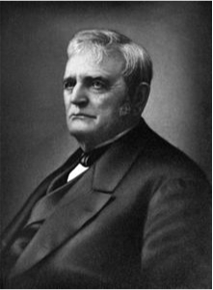
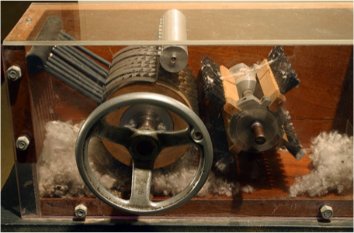
Key Concept 4.2, I
B) New Innovations (Check Video in Description):
Textile Machinery - Spinning Jenny (Samuel Slater)
Interchangeable Parts (Eli Whitney)
Telegraph (Morse Code)
Agricultural Inventions:
Steel Plow (John Deere)
McCormick Reaper
Cotton Gin (Eli again)
All of these inventions increased production efficiency

Slide 5
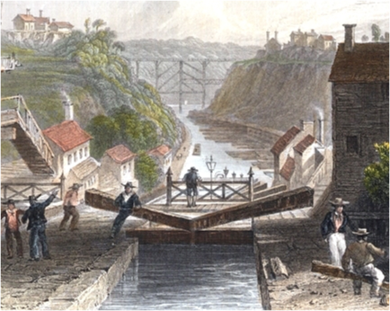
Key Concept 4.2, I
C) Development of Infrastructure:
Roads - Cumberland (MD - OH) - paid for by federal government (Interstate)
Canals - Erie (Albany to Buffalo) - paid for by NYS (Intrastate)
Railroads - B&O - Connected Baltimore to OH
Many projects were paid for by state and local governments, as well as private corporations
Impact?
Connected the North and Midwest more closely than the South

Slide 6
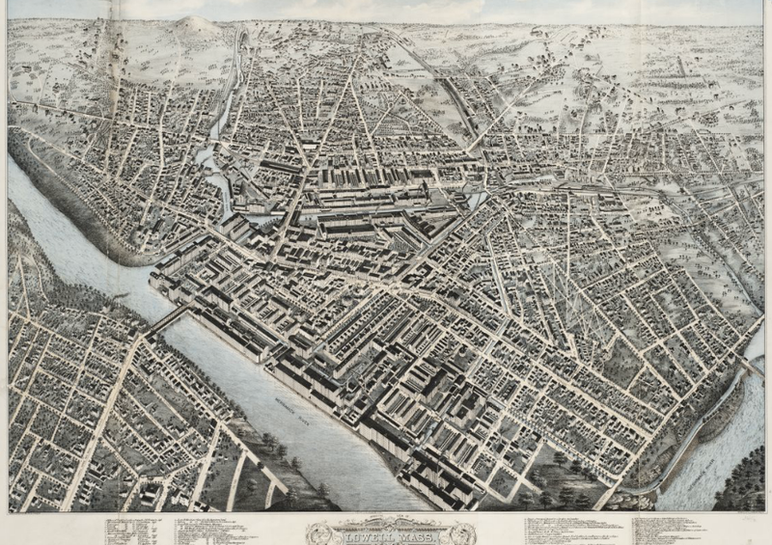
Key Concept 4.2, II
“The changes caused by the market revolution had significant effects on the U.S. society, workers’ lives, and gender and family relations.” pg. 48
A) Shift from subsistence farming:
More men and women worked in factories (no longer in homes)
Early factories were built near water (Lowell, MA)
Produced goods for distant markets

Slide 7
Key Concept 4.2, II
B) Impact of manufacturing and the market revolution?
Growing middle class
Widening gap between the rich and poor
C) Change in gender and family roles:
Middle class women were expected to NOT work outside the home
“Cult of Domesticity” - promoted separate spheres for men and women

Slide 8
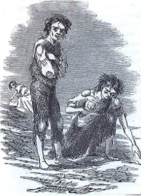
Key Concept 4.2, III
“Economic development shaped settlement and trade patterns, helping to unify the nation while also encouraging the growth of different regions.” pg. 49
A) Immigrants from Europe tended to settle in the East and Midwest:
Increased interdependence between Northeast and Old Northwest
Germans – Ohio as farmers
Irish – cities as urban workers (Potato famine – 1840s and 1850s)
New cities emerged along the OH and MS Rivers
Cities such as St. Louis and Cincinnati (“Porkopolis”) became centers for meatpacking

Slide 9
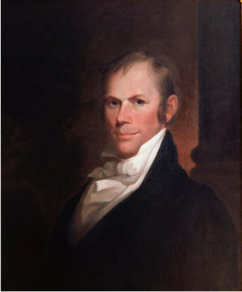
Key Concept 4.2, III
B) Emergence of national ties between the north and South:
Cotton production -> shipped to northern factories
Banks provided funding for factories and plantations
C) Growth of a distinctive Southern identity:
South continued to rely on cash crops (“King Cotton”)
Plantation owners had tremendous power
Many elites defended slavery -> John C. Calhoun’s “Slavery as a positive good”
D) Hopes to unify the US economy - “American System” (see video)
3 parts - BUS, Infrastructure, Tariffs
Tended to be favored by the North and Midwest, NOT the South (tariffs benefitted industry)

Slide 10
Test Tips
Multiple-Choice and Short Answer:
Impact of the Market Revolution (wealth, gender/family roles)
Impact of technology on industry and agriculture
Goals and impacts of the American System
Essay Questions:
Market Revolution
Reasons for sectional tensions/emergence of unique regional identities

Slide 11
See You Back Here For 4.3!
Thanks for watching
Good luck in May!

